Slide 1




The Algorithmic “AI Ecosystem”
Finno-Ugric Data Sharing Space Federating Open Knowledge About Contemporary and Historic Cultural Practices in the Wikibase System
Autonomous systems that drive enterprise value
Dániel Antal CFA, Dr Kata Gábor, Matej Grochal, Britt-Kathleen Mere, Anna Mester, Mihály Nagy, Dr Ieva Pigozne, Bogáta Tímár, Dr Ieva Vīvere.
Daniel Antal, CFA 2025.08.26.

Slide 2
What is AI today?
01

Slide 3

Artificial Intelligence Act
„a machine-based system that is designed to operate with varying levels of autonomy and that may exhibit adaptiveness after deployment, and that, for explicit or implicit objectives, infers, from the input it receives, how to generate outputs such as predictions, content, recommendations, or decisions that can influence physical or virtual environments”
Article 3, harmonised with OECD

Slide 4

ISO/IEC 22989:2022
ISO/IEC 22989:2022 Artificial intelligence concepts and terminology ISO/IEC 42001:2023 – AI Management Systems
"an engineered system that generates outputs such as content, forecasts, recommendations or decisions for a given set of human-defined objectives."

Slide 5
AI & Data Evolution
Systemic thinking: Different technologies work together to make AI scalable, adoptable, and trustworthy
Pattern-based algorithms makes AI widely usable
Usability
Logic AI (knowledge graphs, ontologies) makes AI trustworthy
Large language models
Machine learning, Deep Learning
Each wave made AI more usable; now LLMs make it accessible to management itself
Natural language as the interface to data and AI, dramatic increase in usability and accessibility
Brings AI into management, operations, and everyday decision-making
Seemingly anybody can use it. Open versions only learn from open data. Hallucinations require complex pipelines to avoid.
Semantic web, Internet of Data
Algorithms trained on large datasets, breakthrough in image, speech, and pattern recognition
Explosion of data-driven applications across industries
High performance, but often “black box” and hard to govern
Linking
data across organisations and domains
Ontologies and metadata standards to create common meaning, a kind of “metaprogramming” for data: applying formal logic above software for interoperability. Foundation for today’s knowledge graphs and federated data
K-base, knowledge graphs, expert systems
Rule-based systems, knowledge graphs, structured decision logic High accuracy in narrow domains, but limited scalability and usability.
1991-2000
2001-2010
2011-2020
2021-

Slide 6
What are AI algorithms today?
Different algorithms can help to eliminate error-prone human workflows, or make humans more capable
Algorithm | Analogy | Corporate use
Pattern recognition | Finance forecasting | CFO: “when did the suppliers were that late last time, what is behind this”
Pairing | Buildings, people, addresses | Back office: „why 1.3% of the postal letters come back with address unknown marking.”
Language interaction | Legal due diligence | Compliance: “which local authorities used the same regulatory requirements in the past 30 years”
Inference | Applied logic | Real estate: “which client statements are contradicted by our documents our cadastre and court title documents”
Agent | Autonomous execution | Chat bot, automated table filling and imputation

Slide 7
Trustworthy AI
An AI-inferred statement like
3400 HUF spent on Diesel → results in 128.24 kg of CO₂ becomes a verifiable fact in a well-structured knowledge base.
AI
Transform data to knowledge
Linking to scientific facts (1 litre of Diesel burns to 2.68 kg of CO₂) and expressing it in semantic statements with TRUE/FALSE value turns data into actionable and verifiable knowledge for financial control, sustainability, or legal compliance.
KNOWLEDGE
Translate data to knowledge statements
INFORMATION
Adding metadata makes data human-readable and professionally interpretable
Adding labels and metadata
Metadata like 34000 HUF or Diesel fuel with a unit price of 500HUF/litre makes the data interpretable for both humans and machines when encoded with standard ontologies and labelled in English or Hungarian.
DATA
Interpreting bookkeeping, HR, or environmental data requires expert knowledge. Raw accounting data is not directly usable by ESG or compliance professionals
Data needs interpretation
The labels 34000 or Diesel lack meaning without units, definitions, or context. Switching between legal, ESG, rights management, financial controlling or audit contexts requires much metadata.

Slide 8
What Does an Algorithmic “AI Ecosystem” Look Like?
02

Slide 9





























The Ecosystem of Artificial Intelligence
AI agents are embedded in your products, services and workforce — but they also empower your consumers and competitors.
Agents – autonomous systems
Következtetés
Expert system, knowledge base, inference engine.
Machine vision, OCR
LLMs
Deep Learning, Neural networks.
Machine learning
Tudás
Artificial Intelligence
Adat
Local & cloud computing
Internet
Sensors, Internet of Things
Databases, graphs
Data infrastructure

Slide 10
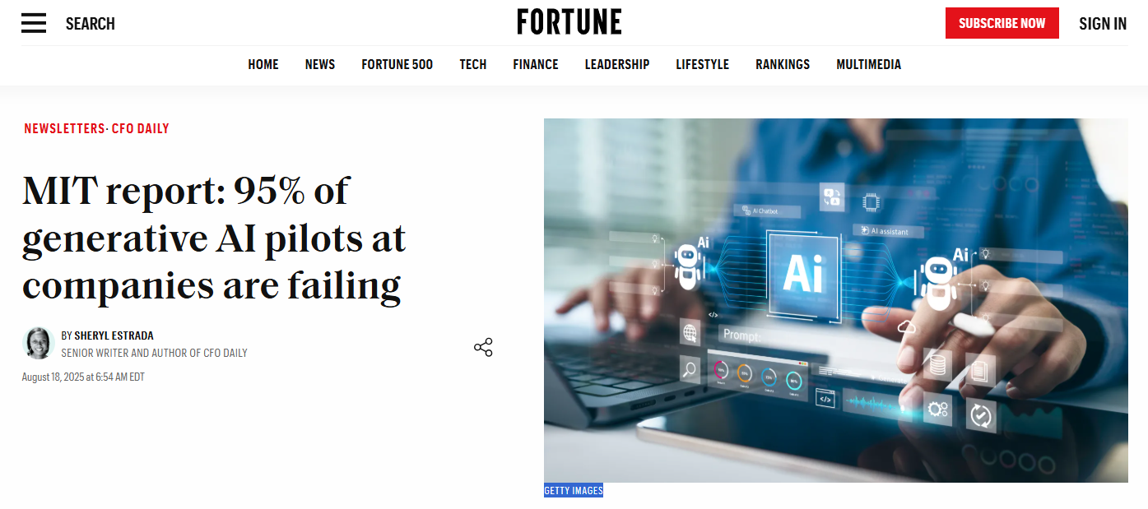

Slide 11
What AI Really Costs Compared to People and Systems
AI is almost free — the expensive part is making it trustworthy and usable.
AI is cheap — the real cost lies in people, governance, and integration
The source of the value is the human resource, the cost algorithmic infrastructure and software is very low
A ChatGPT Pro subscription costs less than a gym membership.
The computing power to run AI is cheaper than the annual license and amortization of a mid-sized ERP system — and less than the fully loaded cost of an average employee.
An outsourced AI model or service costs far less per month than the salary of an engineer, compliance officer, or IT manager.
The implementation of algorithmic AI often stays below restaurant representation costs.
coffee
tokens
ChatGPT Pro
Pro tokens
Laptop lease
GPU amort
ERP amortisation
átlagbér
GPU cloud
mérnök
Data compliance
IT managmeent
Approximate costs and prices in Hungary and Europe, 2025.

Slide 12
Where Will It Create Proven Corporate Value?
03

Slide 13
AI Create Corporate Value
AI Use | Workflow | Corporate Process
OPEX reduction | Automation of small office task | Back-office optimisation, bookkeeping, data entry
CAPEX optimisation | Better financial modelling | Predictive maintenance, better financial modelling of asset lives, etc.
Working capital management | Supply chain and cash flow optimalisation | JIT, predictive procurement, storage and route optimisation
Human resources | Selection, assessment, enhancing missing skills | AI agents help less skilled or aging workforce remain competitive, better replacement and recruitment
Sales | Personalisation, marketing, self-service | Dynamic pricing, web optimalisation, chatbots, targeting -→ most companies only try AI in this area.
Compliance | Automated reporting | ESG reports, regulatory and stock exchange reports, review of regulatory requirements
Strategic IP | Knowledge capital | ESG knowledge graph, supplier scoring, built environment monitoring

Slide 14
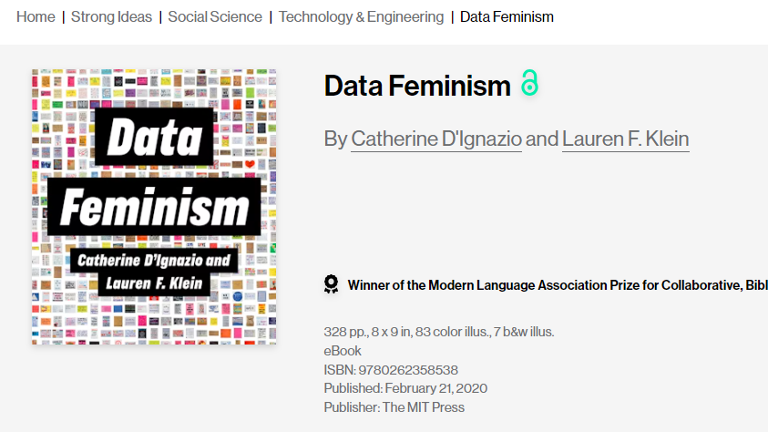

Caution and Trustworthiness: Criticism of Algorithmic Automation
Algorithms do not work equally well for small companies, women, non-American audiences. If we do not know their in-built data, training biases, or the interest of the creator, then we will not know when they work against us, and not for us.
In the last decades, every new family of algorithms and technical breakthrough was always followed by scandals of misue or unexpected side-effects

Slide 15


Competitive Advantage: Only the Top 5% Succeeds And Stay Ahead
Enterprise Gen AI
According to MIT NANDA the gen AI projects of large global companies in
95 %
did not create value.
[Sanitized]
67% of successful projects relied on external AI know-how

Slide 16
Autonomous operations inside the enterprise
04

Slide 17
Who Owns the AI Ecosystem?
Turn curated data + AI into competitive advantage in finance, planning, sales, HR, products and services.
Management: turn AI to competitive edge
Következtetés
Expert system, knowledge base, inference engine.
Machine vision, OCR
LLM, ChatGPT, Gemini
Deep Learning, Neural networks, machine learning.
Machine learning
Tudás
CDO – data and digitisation as capital
Adat
Local & cloud computing
Internet
Sensors, Internet of Things
Databases, graphs
CIO: maintain data infrastructure

Slide 18
Skills, Responsibilities, Organisation
05

Slide 19

For Big Data And AI Almost Everybody Is Small
23 million European SME, 96% with less than 10 people
1 million non-profit organisation
2700 universities …all competing for the same AI & data specialists
Not every organisation can build big data lakes or proprietary algorithms. For most, data sharing and reuse are the only viable strategy.
AI talent is very limited
otologists
Information scientists
data & AI engineers
statisticians
are trained in small numbers.
The use of data sharing spaces and re-use of open-source models alleviates the need to pay premium HR costs for very scarce talent
[Sanitized]

Slide 20
Trustworthy AI
An AI-inferred statement like
3400 HUF spent on Diesel → results in 128.24 kg of CO₂ becomes a verifiable fact in a well-structured knowledge base.
AI
Transform data to knowledge
Linking to scientific facts (1 litre of Diesel burns to 2.68 kg of CO₂) and expressing it in semantic statements with TRUE/FALSE value turns data into actionable and verifiable knowledge for financial control, sustainability, or legal compliance.
KNOWLEDGE
Translate data to knowledge statements
INFORMATION
Adding metadata makes data human-readable and professionally interpretable
Adding labels and metadata
Metadata like 34000 HUF or Diesel fuel with a unit price of 500HUF/litre makes the data interpretable for both humans and machines when encoded with standard ontologies and labelled in English or Hungarian.
DATA
Interpreting bookkeeping, HR, or environmental data requires expert knowledge. Raw accounting data is not directly usable by ESG or compliance professionals
Data needs interpretation
The labels 34000 or Diesel lack meaning without units, definitions, or context. Switching between legal, ESG, rights management, financial controlling or audit contexts requires much metadata.

Slide 21

Future-Proof Solutions
The Ise Grand Shrine has stood for 1,600 years not because the wood never rotted, but because the knowledge of renewal was passed on from generation to generation. The design of regeneration and the embedded know-how were the true asset, not any single plank of wood. A federated data sharing space with curative AI works the same way: it doesn’t just store clean data, it preserves how to fix corrupted records, reshape data for new systems, and upgrade databases while staying compatible with legacy software. That makes it future-proof — ready for the next systems — and past-proof, since it still works with the old ones.
Images: .伊勢神宮 Ise Grand Shrine, a wooden building that has been in use for 1,600 years thanks to regeneration plans handed down across hundreds of generations.

Slide 22
Algorithmic AI in the Organisation: Chief Data Officer
CFO, COO, CHRO, and product owners embed AI in finance, HR, operations, and products. Expect them to learn to supervise the human-in-the-loop — and to buy AI tools the CDO can feed with trustworthy input and control data.
Leadership: competitive advantage
Inference
Empower a CDO to design a federated data sharing space that protects existing ownership and compliance — but also curates and feeds data proactively into human-controlled, trustworthy AI.
Knowledge
CDO: knowledge capital
Data
No big new investments needed — AI can work even with legacy systems and old PDFs, as long as the infrastructure holds.
Reliable infrastructure

Slide 23
Algorithmic AI in the Organisation: IT
Future-proof AI with a data sharing space creates value in the business layer by enabling better OPEX, CAPEX, HR, and sales decisions.
With a conservative estimate, a system that costs EUR 30,000 to run monthly, with 20% discount rate, will break even if it yields 10% OPEX gain on a cost base of ~EUR 3.6 million.
Curative AI in the IT layer creates value by prolonging asset life and reducing replacement needs, avoiding full modernisation cycles.
The same system will break even with 1% savings on an annual IT budget of ~EUR 36 million — even if there are no actual gains on OPEX, CAPEX, HR, or sales.
Inference
Knowledge
Data
No big new investments needed — AI can work even with legacy systems and old PDFs, as long as the infrastructure holds
Reliable Infrastructure

Slide 24
Chief Data Officer
06

Slide 25
Why CDOs Fail? How to Make Them Strategic?
What is the Problem?
Why CDOs Usually Fail?
Solutions
Unrealistic expectations
Expected to deliver enterprise transformation in <18 months
Pressure for immediate ROI from data initiatives
Ambiguous/unrealistic goals make value hard to prove
Cultural resistance to new ways of working
Lack of Authority, Unclear Boundaries
Unclear reporting lines (often to CIO, not CEO)Governance fragmented across IT and business units
Many CDOs stuck in compliance rather than delivering business value
Insufficient resources/budget to drive cross-company change
In Europe, data governance is confused with a narrow data protection (what not to do with the data.)
Skill Misalignment / Capability Gap
Many CDOs come from IT or compliance backgrounds, not analytics or AI, CDOs perceived as “glorified IT or compliance managers”
Organizational frustration: lack of advanced data curation, analytics, proactive data governance and algorithmic skills
Knowledge as Capital, not IT
Mandate anchored in business value creation
Report to CEO/COO
KPIs linked to financial and strategic outcomes
Quick wins to bring acceptance and clarity to the role in the organization
Empowerment and Infrastructure
Enterprise data sharing space (not siloed data lakes)
Clear authority over governance and curation
Adequate resources
Acquire Skills
Hire or upskill for data curation, analytics, and algorithmic literacy
Surround CDO with data stewards embedded in business functions
3
6
High attrition rate
Average tenure 1.7-2.5 years
High turnover
Often demoted below CIO
Vague mandate
Compliance vs. transformation
Only 40% of companies feel the CDO/CDAO role is well understood
1
2
4
7
5
8

Slide 26
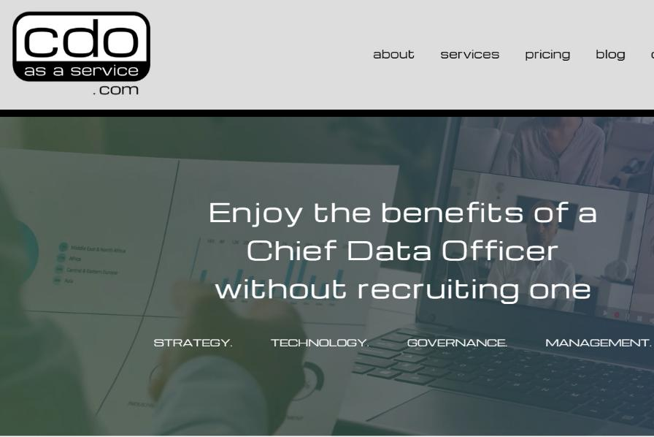
CDO as Service?
Outsourcing happens, particularly among medium-sized enterprises
CDO roles are immature and fragile
Many medium-sized and even large firms lack a CDO.
Where appointed, success is rare and attrition high.
No urgency to appoint
Over the next 2–5 years, data governance, knowledge capital, and AI will become central.
At that point, a strong CDO may be needed — or will emerge naturally.
De-risk with an external partner
Early failures can be avoided by starting with an external knowledge capital partner to build infrastructure, workflows, curation practices, and culture.
Federated approach fits the group
With data federation, normalization, and knowledge graphs in place, management understanding matures
An external partner reporting to CEO/COO avoids clashes with CIOs or BU leaders.

Slide 27
Reprex
07

Slide 28
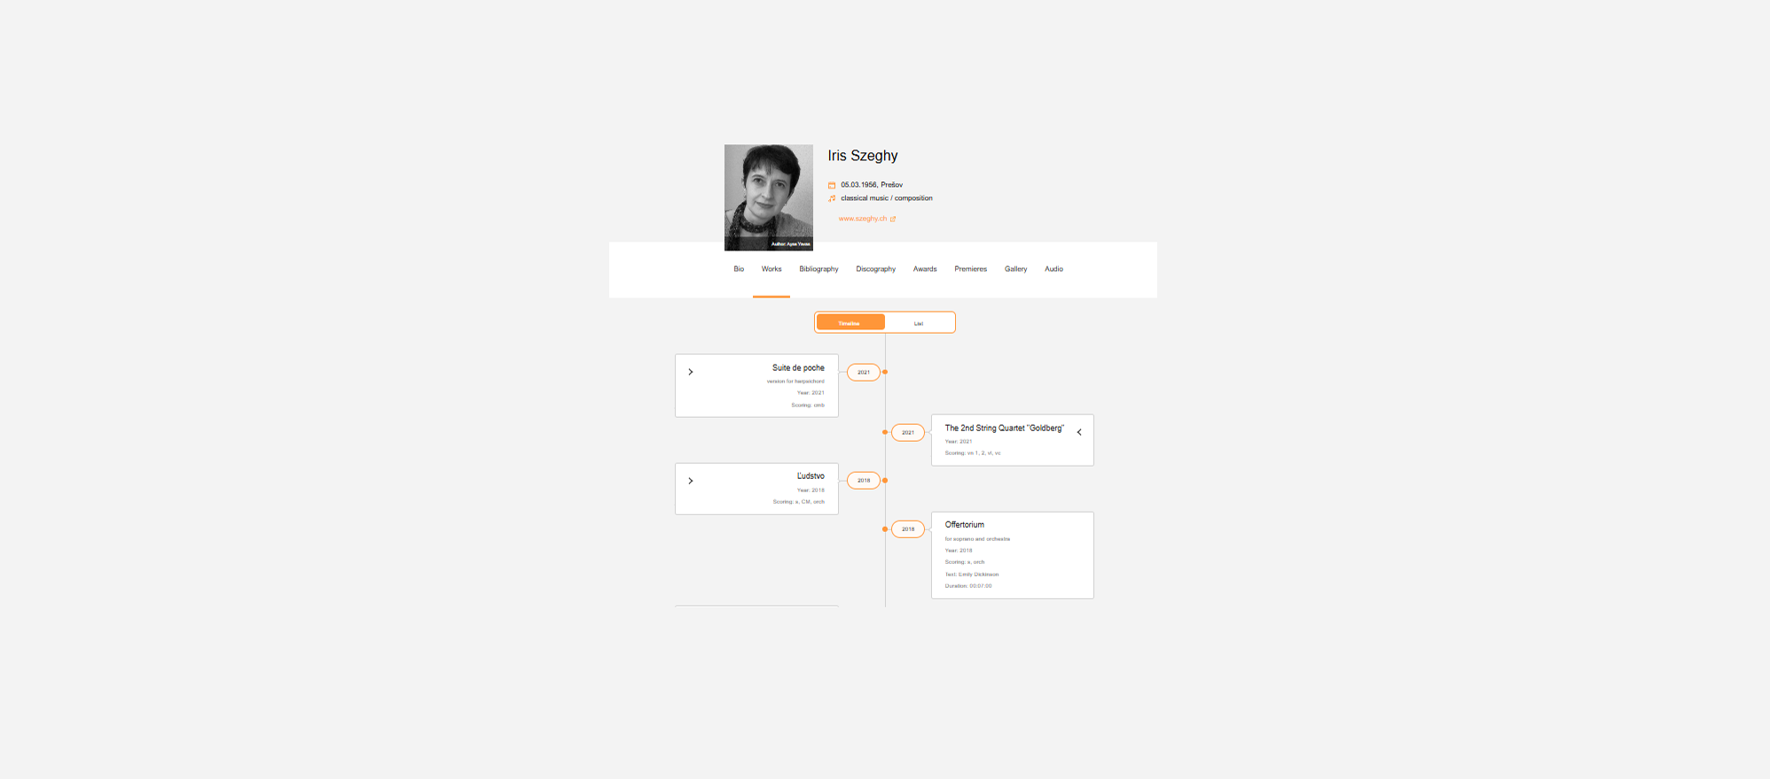


















Data sharing and exchange in the Slovak music data sharing space
We use AI to understand, connect, cross-enrich and correct the outputs of heterogenous and obsolete systems
Data health checks
Ensure that streaming services can recommend the music and pay out artist
Printed music
Increase the availability of printed music via webshops and library access
Improve recommendations
Music info centre sends authoritative repertoire data
Integrate libraries
Enable search in libraries and archives, locate printed music and records for public lending
Improve statistics
Satellite business register coordination for better surveys of music
Local content regulation
Help radio stations to comply with legal local content quotas.

Slide 29


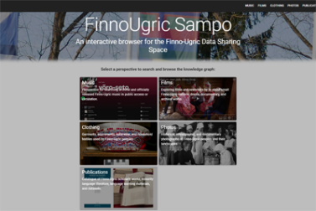








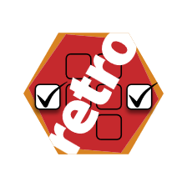
















Our systems
We can build from open source or enterprise components systems that cross corporate, private/public boundaries to build an optimal knowledge capital for our users
Application layer, f.e., Sampo click-and-play semantic browser
Conceptual and data model
Our peer-reviewed, scientific software libraries and ontological patterns standardise the data
data curation from sources

Slide 30
Data Sharing Space for Optimal Knowledge Capital Increase
We create data (sharing) spaces that not only follow the models of the European Interoperability Framework and EOSC and extend to interoperability with private partners
Your Data Sharing Space
Our solution involves the creation of a data sharing space, an automated data governance tool that synchronizes your group’s data with the data from the rest of the world.
Open Science
In most developed countries, a large part of science is publicly funded and the results of science are available for free. Such data may help in innovation, sustainability management, and other areas where the internal knowledge capital of the company is weak.
EOSC Open Science
Coordination of privately-held and public sector data
The Data Governance Act and various statistical regulations allowing novel data coordination between privately-held and governmental data. This allows the company to optimally increase its knowledge capital about prospects, clients, suppliers, and the built and physical environment.
Public sector information reuse (open data)
The Open Data Directive (2019/1024/EU), the Data Governance Act (2022/868/EU) gives legal access to much data for free or at marginal cost which are not available from private vendors (satellite images, building cadastres, jurisprudence databases.)
Collective management, publishers, labels, “Unlabel”
EIF Public sector information reuse

Slide 31


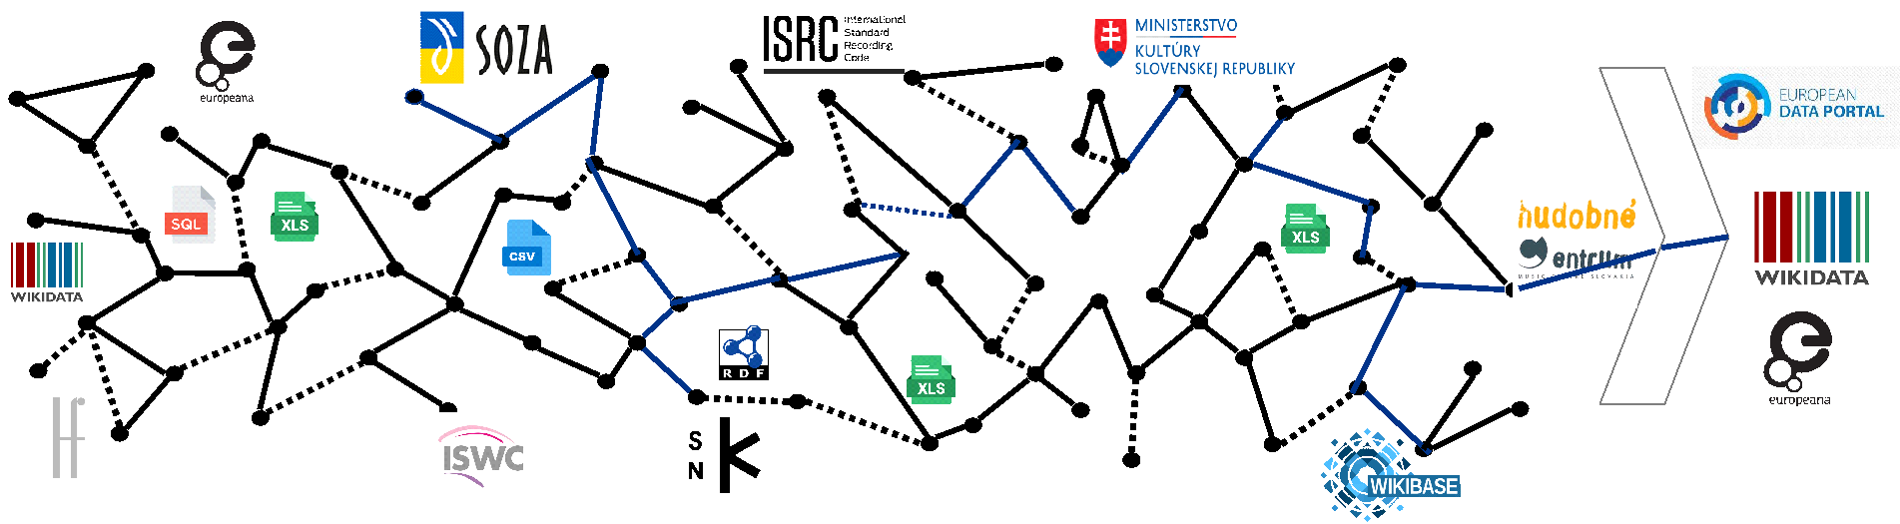


Multi-Organisation Exchange Requires Governance of Continuous Data Improvement, Better Standardisation (Our Slovak Music Use Case)
1. Data enrichment and cross-checking
Reprex consolidates the data Excel, CSV, SQL and other database (data file) formats of SOZA, Slovak Music Centre, Music Fund, and other organisations into a graph format. We assist curators to find and improve errors in their metadata. We ensure that the resulting data is more usable for rights management, heritage management, publishing.
2. Data dissemination
We send the enriched and proprietary (confidential) data to the systems of SOZA, Slovak Music Centre, Music Fund or other participants. We sent the public data to the EU Open Data Portal (statistical data), to EOSC (data of scientific value), collections data (Europeana and ECCH), and biographical and repertoire data to Wikidata and Wikpedia. This way streaming providers can use reliable data about Slovak music.

Slide 32




European Interoperability Framework: Layers of Service Interoperability
Legal interoperability
Rules of the data exchanges and use is harmonised to a level that negotiations and permits can be obtained fast to join the data.
Organisational interoperability
Organisations harmonise their internal workflows and jobs that use data to benefit the most from improving and enriching their own data with other sharing partner’s data.
Integrated service governance
Semantic interoperability
The jobs and workflows of the organisations in the data space share a vocabulary of meanings of the collected and shared data’s definitions and meanings.
Technical interoperability
The data is translated to a standard graph format with shared annotation so that it can be easily exchanged, synchronized among partners.

Slide 33













REPREX
Algorithms that work for all
Big data for all
Open technology for all
Open knowledge for all
As members of the Dutch AI Coalition, we help public and private users adopt AI they can trust. Our solutions meet the strictest regulatory standards and are built for sensitive sectors—banking, cultural heritage, education—where fairness, transparency, and accountability are essential. We design AI systems that legal, auditing, and sustainability teams can confidently and conveniently control.
Our data sharing space model standardises access and governance, enabling public and private partners to share data safely for training AI. We connect open government, open science, and sector-specific datasets—so even small actors can benefit from large-scale, compliant data use.
We build and maintain open-source libraries and components that extend the R data ecosystem and leading graph tools. But we don’t stop at code—we customise, integrate, and deliver them as Software-as-a-Service (SaaS), so even small institutions can benefit without local IT support.
Most organisations don’t have access to true big data—but they can tap into big knowledge. We create shared, reliable knowledge bases from open and institutional sources, making high-quality data available to train algorithms that work for users, not against them.

Slide 34



Questions?
Reprex reprex.nl/contact
Daniel Antal www.linkedin.com/in/antaldaniel

